Slide 1
Agile vs Waterfall
By
Aradhna Rajendran

Slide 2
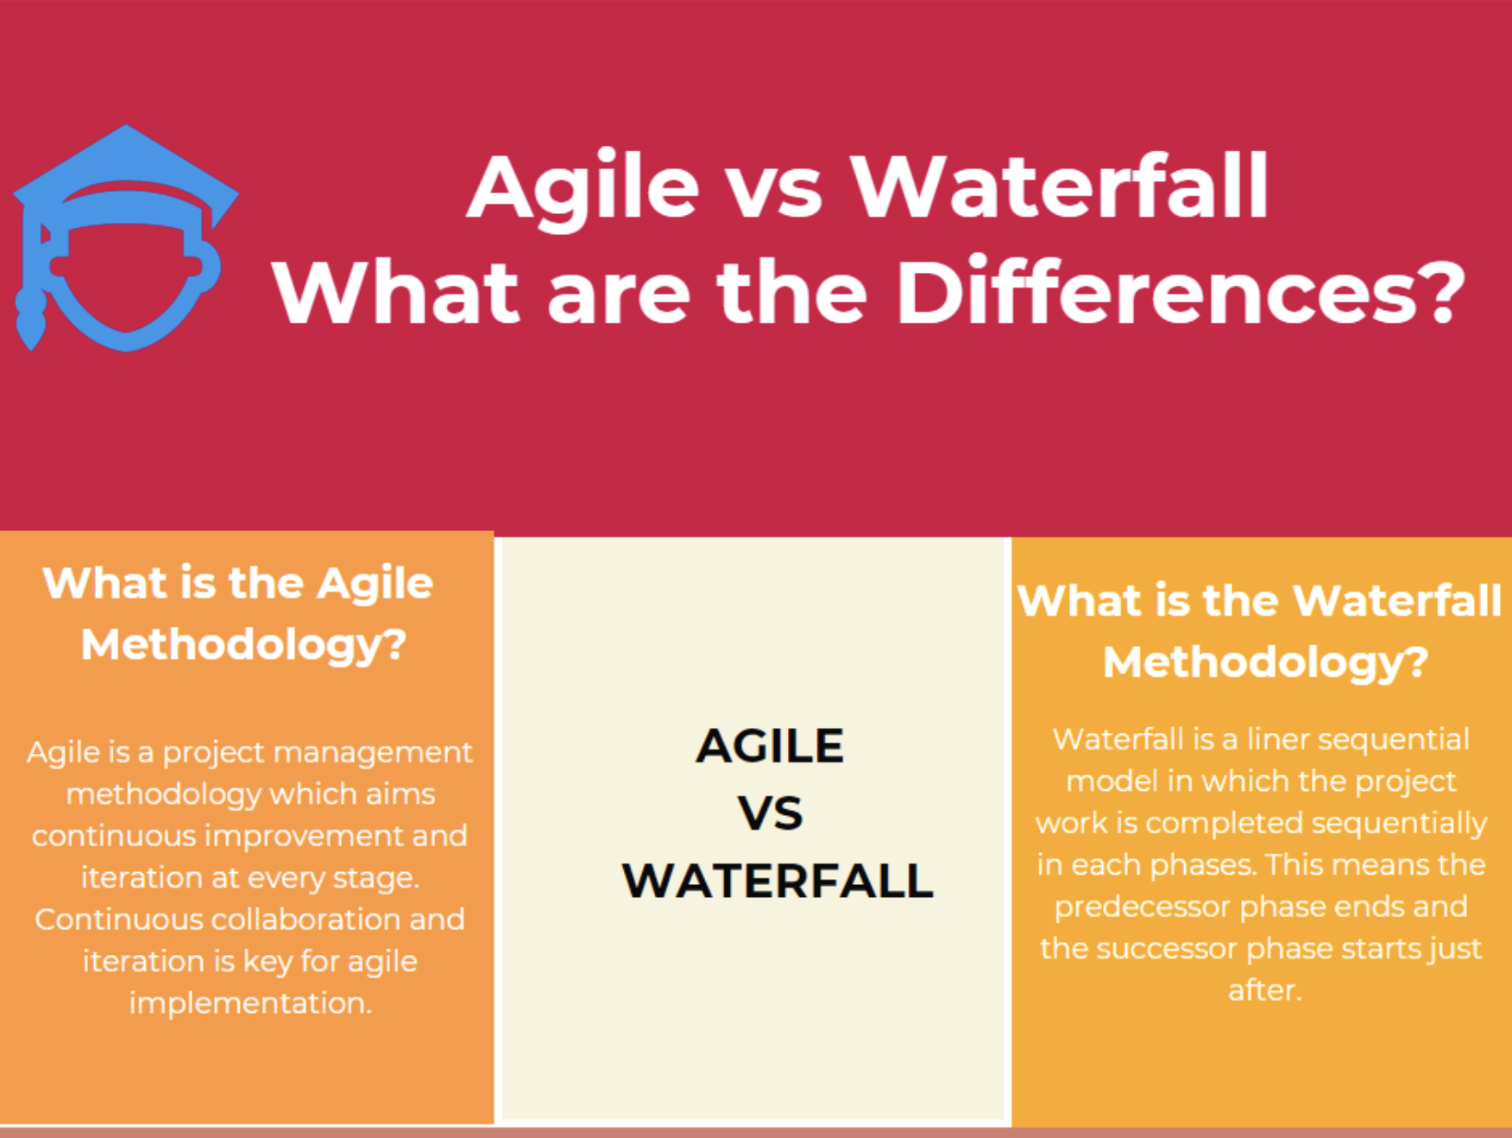

Slide 3
Agile Methodology
What is the Agile Methodology?
Agile is a project management methodology that aims at continuous improvement and iteration at every stage. Continuous collaboration and iteration are key for agile implementation. Scrum, Kanban Methodology, Extreme Programming (XP), and Adaptive Project Framework (APF) are the agile frameworks.
Advantages of Agile Methodology
Since the agile projects are client-focused, agile makes sure that the client is involved in every stage continuously.
The team members demonstrate better performance. Because coordination and collaboration among team members are key for the success in agile projects.
The agile project management methodology ensures that the quality of the product is maintained.
Risks are minimized because the process is based on incremental progress.
It is applicable to large and complex projects.
Limitations of Agile Methodology
It can not be effective in smaller projects.
If the client is not clear about the final product, the project can easily go off track.
The Agile methodology requires a senior programmer to take important decisions during the meeting.
It is costly considering other methodologies.

Slide 4
Waterfall Methodology
What is the Waterfall Methodology?
The waterfall is a linear sequential model in which the project work is completed sequentially in each phase. This means the predecessor phase ends and the successor phase starts just after. The waterfall is a straightforward methodology for project management that helps to perform progress measurement easily. The testing phase takes place at the end of the development. The client or stakeholders are not too much involved compared with the agile methodology.
Advantages of Waterfall Methodology
Each sequential phase has specific needs and deliverables. This makes it easy to plan and manage.
It suits best for projects with well-defined scope and requirements.
It suits best for smaller projects.
It speeds up the deliveries of the project
Everything is well documented
Limitations of Waterfall Methodology
It is suited to smaller projects rather than large and complex ones.
If the project requirements are not defined well at the beginning, it will be less effective.
It will be difficult to turn back to the previous phases and apply changes as the project progresses.
Testing takes place just after the end of the development process. For this reason, it is expensive and time-consuming to turn back and fix the errors.

Slide 5
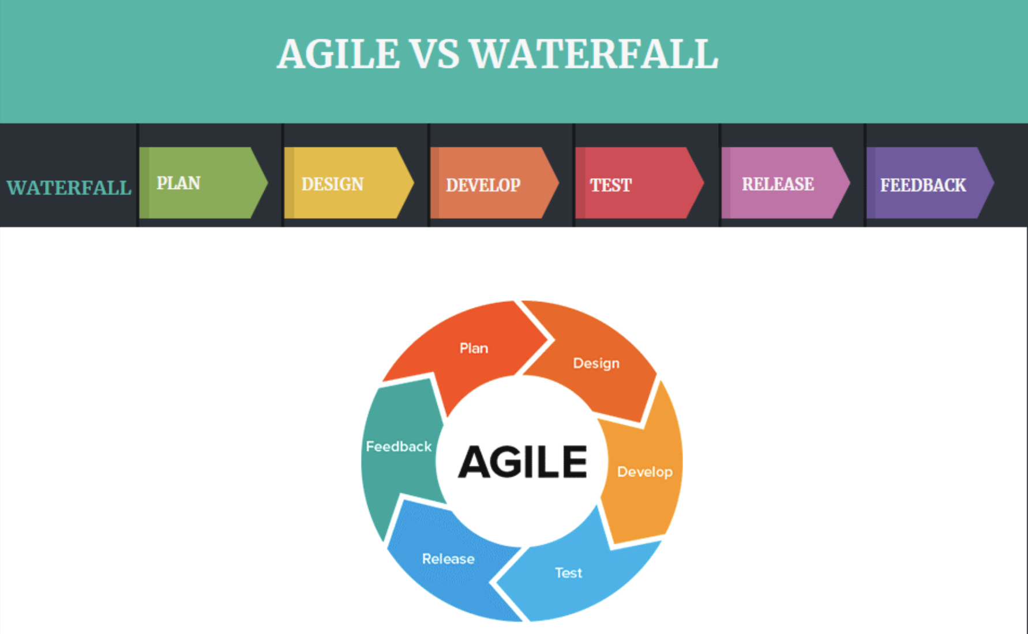

Slide 6
Agile methodology | Waterfall methodology
Divides the project development lifecycle into sprints. | Divides the software development process into distinct phases.
Follows an incremental approach | Follows a linear sequential approach
It is a flexible methodology | It is a rigid structural methodology
Agile can be considered as a collection of various projects | It will be done as one single project.
It is easy to make changes because of its flexibility | It is difficult to make changes
The test plan is discussed after the completion of each sprint | The test plan is reviewed during the testing phase
Project requirements are subject to change | The waterfall is suitable for projects with definite requirements. Changes are not easy. Agile vs Waterfall
Agile is a customer-focused methodology. Changes on the product are as per the customer’s requirements | Waterfall methodology relies on definite project requirements
A fixed project budget is not suitable for the implementation of agile methodology. There may be some flexibility. | Since all the requirements and the project scope is defined well, the project budget does not change too much.
High communication and collaboration among the team members | Low communication and collaboration among the team members
The product owner and the project team collect the requirements every day. | All the requirements are defined before starting the project.
Follows an iterative development approach so that planning, development, and testing phases may appear more than once. | Phases are linear and sequential. Once a phase is completed, the next phase starts.
Testing is performed in conjunction with software development. | The testing phase comes once the build phase is completed.

